Slide 1
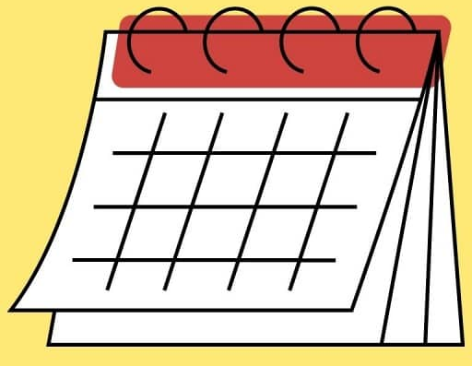


Let’s LevelUp
Mentor –Mentee Program
Powered by – I&D Data Engineering

Slide 2
Why are we launching this program?
1
Engagement- Weekly 1:1 discussion followed by review (30 minutes)
2
Coaching and Mentoring –Make A band ready for project interviews, Certification Guidance, Capgemini know- How
3
Empower and Encourage personal development – Provide Assignments, more hand-on experience and review the same with detailed feedback
4
Participate in LevelUp program and Monthly Milestone discussion & review
5
Try to look for an opportunity to make them Billable or Shadow in projects by working with your own connects, RMG and competency leads

Slide 3
How to get started?
Ways of Working
We will allocate 1 – 5 freshers under each C1 from same competency and same location
Capture all your engagements/Conversation with A band (Format will be shared)
Ensure that there are regular touchpoints
Communication & Engagement
As a mentor, the onus lies with you to ensure you that post the engagement that the conversations are updated
Engage with your mentees and proactively and manage concerns raised during your conversation
Toolkit
The deck will be provided to you for reference
Engagement tracked through Forms
Measure
A band ARVE Utilization : We can see improvement in ARVE% and shadow deployment
Promotions: more A bands being coached, mentored and promoted

Slide 4
We want you to make it a success!
Each Mentor makes it a success
1
Commitment and engagement from you as Leaders
2
Genuinely engage and have conversations with your Mentee
3
Capture aspirations and needs – proactively highlight it to your leaders

Slide 5

Program Construct
Week 1
Awareness program : Mentor and mentee
Know your mentor
Projects worked so far
Professional Accomplishments
Personal Accomplishments
Interest outside of work
Mock-up Interview
Awareness program : Competency and I&D
Know your competency
Understand I & D
Know your competency lead
Networking with peers
Week 2
1:1 Feedback session between mentor and mentee
Assignment review
Upskilling plan
Readiness for certification
Feedback Form –Mentee progress (Activity will be on monthly basis)

